Slide 1

DIABETES PREDICTION SYSTEM USING MACHINE LEARNING
Presented by
Geeta Jyothi Perabathula (245621737051)
Akshita Puligadda (245621737054)
Shanmukha Priya Jonnana (245621737306)
Name of the Guide: Dr. Padmalaya Nayak

Slide 2
Abstract
Diabetes is a chronic metabolic disorder characterized by high blood glucose levels, which can lead to severe health complications if not managed properly. Early diagnosis and treatment are crucial for improving patient outcomes. This project aims to develop a diabetes prediction system using machine learning techniques to assist in early detection. The system leverages Logistic Regression, Support Vector Machine (SVM), and Random Forest classifiers to predict diabetes based on patient data, including age, insulin levels, pregnancies, skin thickness, diabetes pedigree function, and blood pressure. The models are trained on a balanced dataset to ensure reliable predictions. A web application built with Django provides an intuitive interface for users to input their health parameters and receive predictions. The accuracy of the models is evaluated and compared, providing users with a robust tool for diabetes risk assessment.
Keywords: Logistic Regression, Support Vector Machine, Random Forest classifiers

Slide 3
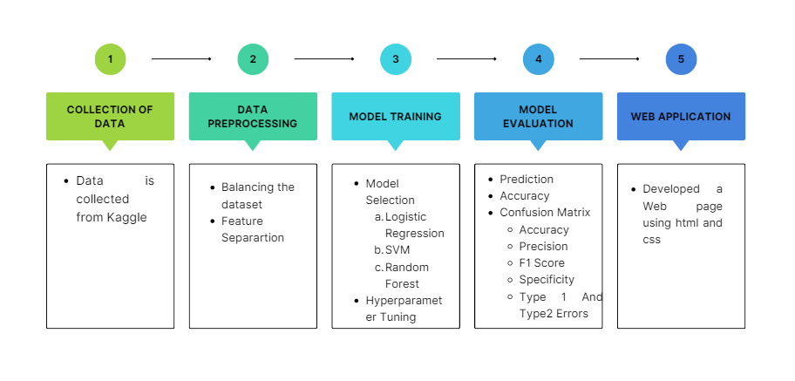
Proposed Methodology

Slide 4
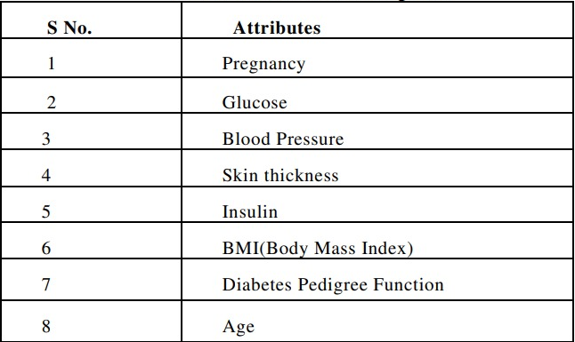
Attributes Used

Slide 5
RESULT
Accuracy
Precision
F1 Score
Specificity
Type 1 And Type 2 Errors
Web Application

Slide 6
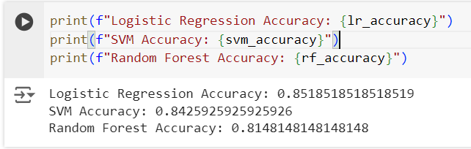
Accuracy

Slide 7
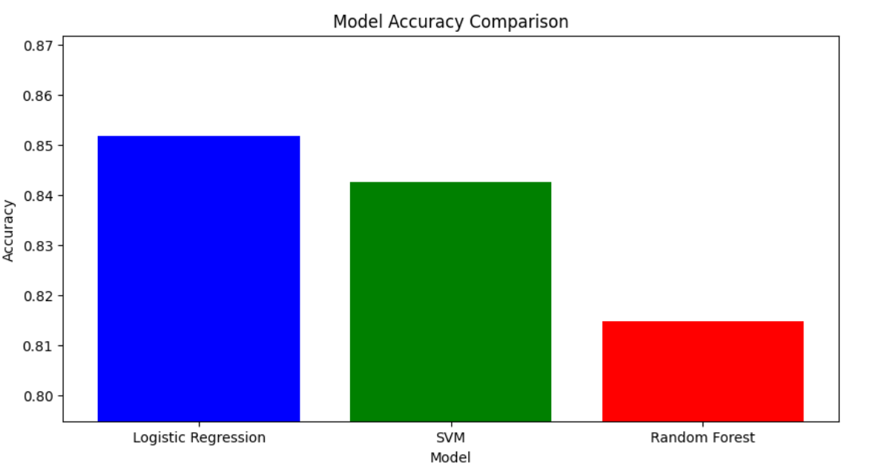
Model Accuracy Comparison

Slide 8
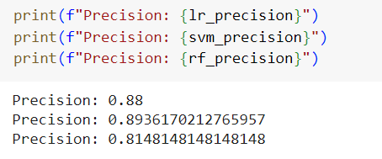
Precision

Slide 9
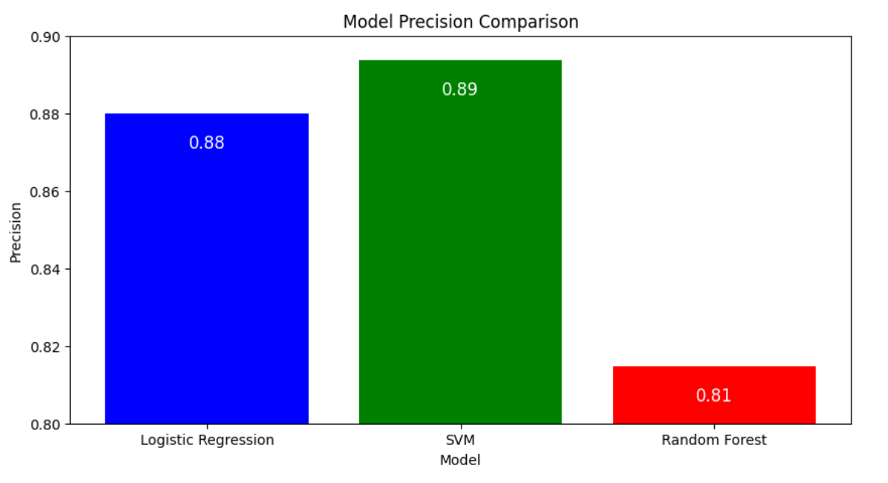
Model Precision Comparison

Slide 10
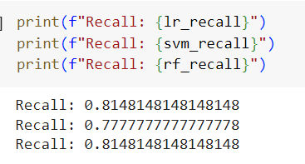
Recall

Slide 11
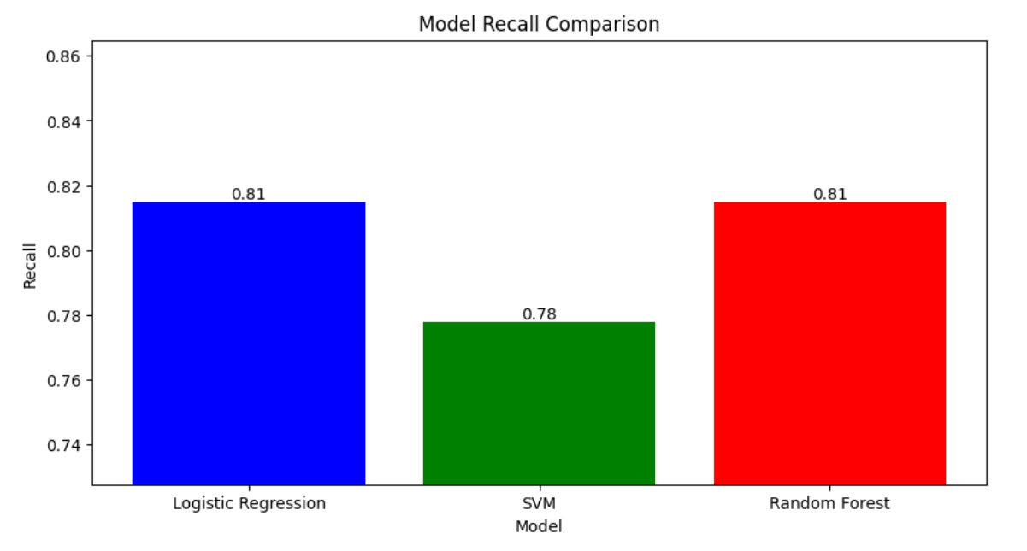
Model Recall Comparison

Slide 12
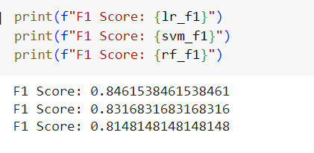
F1 Score

Slide 13
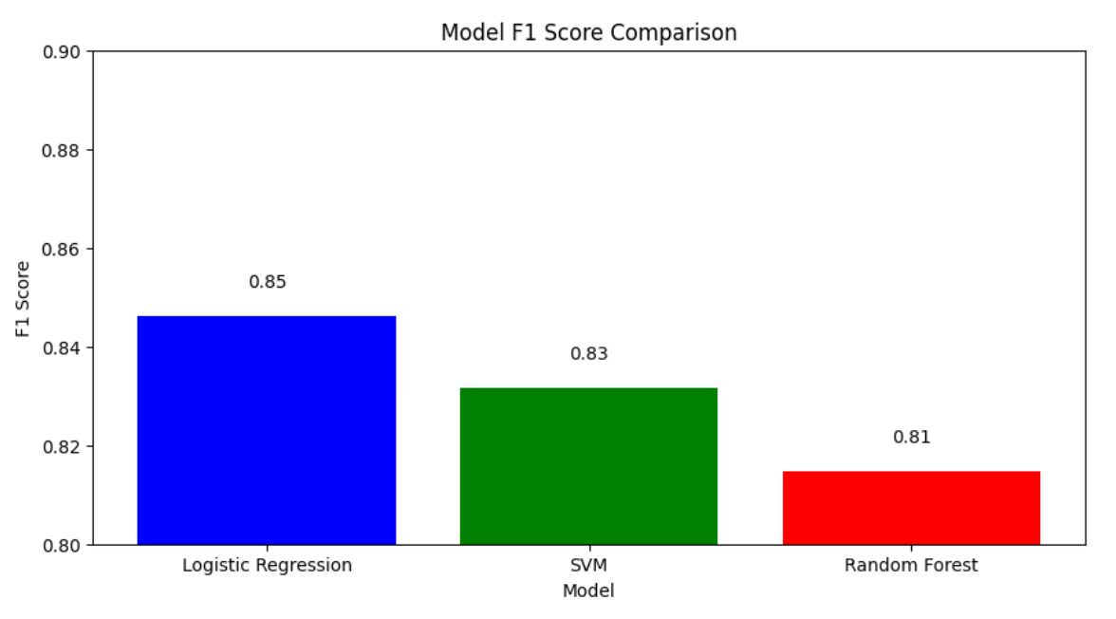
Model Precision Comparison

Slide 14
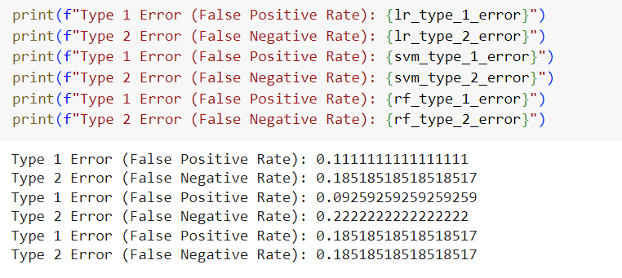
Type 1 and Type 2 Error

Slide 15
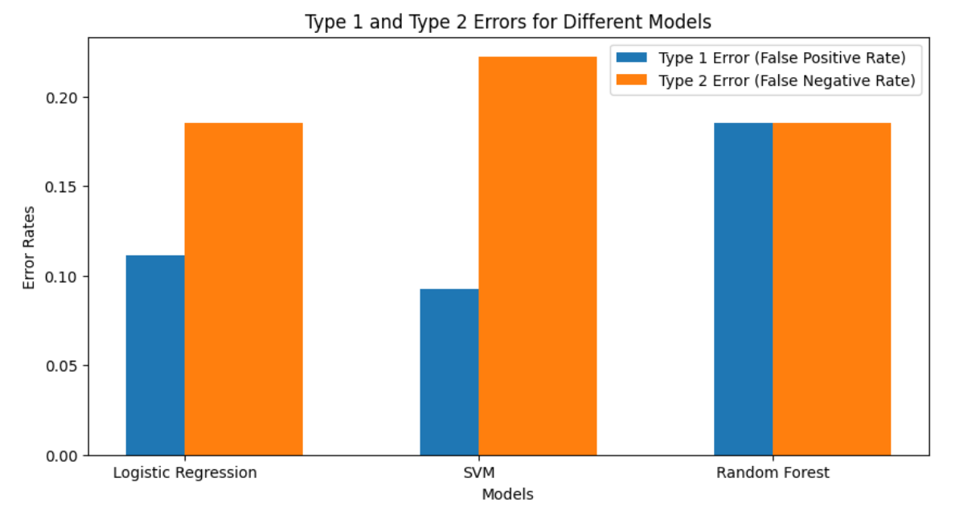
Model Type 1 and Type 2 Error Comparison

Slide 16
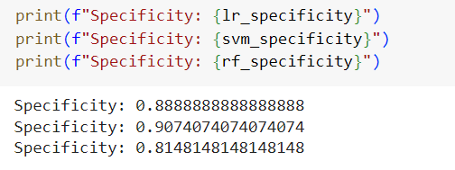
Specificity

Slide 17
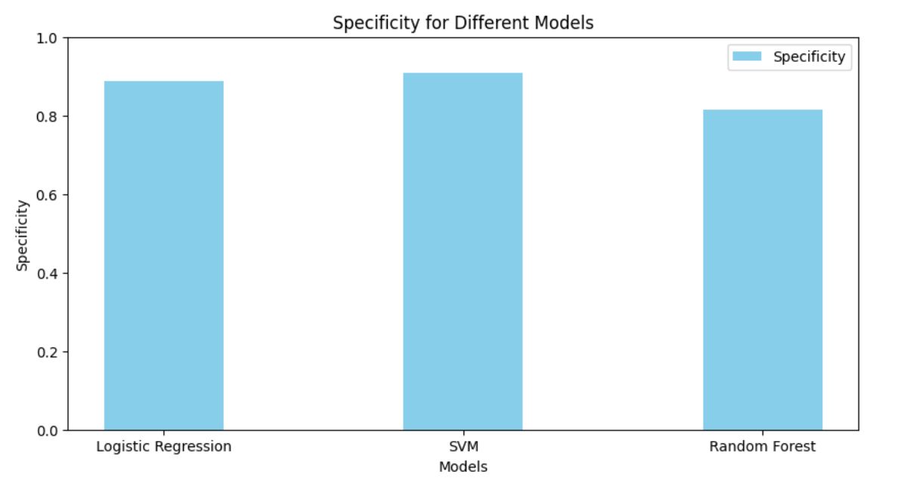
Model Specificity Comparison

Slide 18
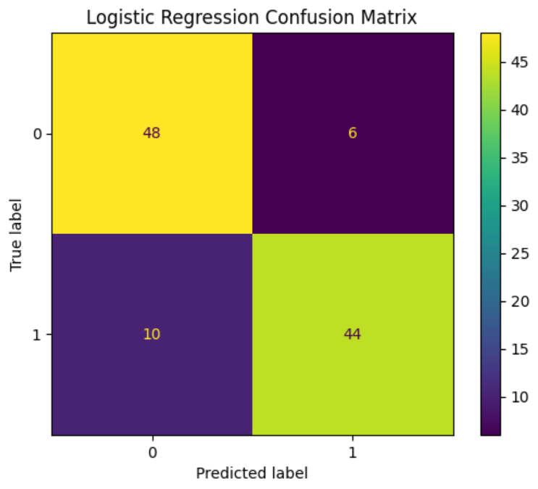
Confusion Matrix For Logistic Regression
TN
FN
FP
TP

Slide 19
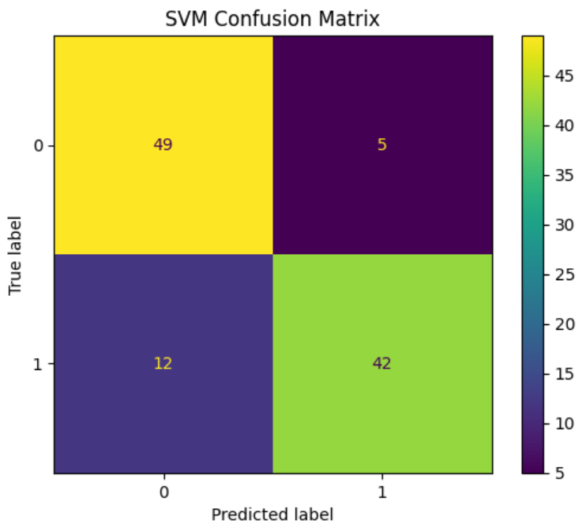
Confusion Matrix For SVM
TN
FN
FP
TP

Slide 20
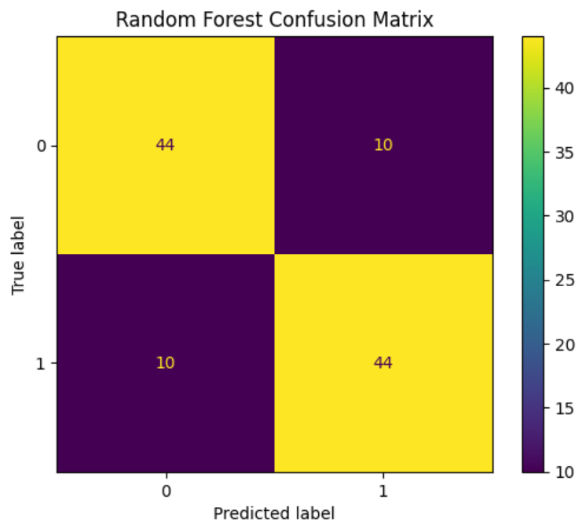
Confusion Matrix For Random Forest
TN
FN
FP
TP

Slide 21
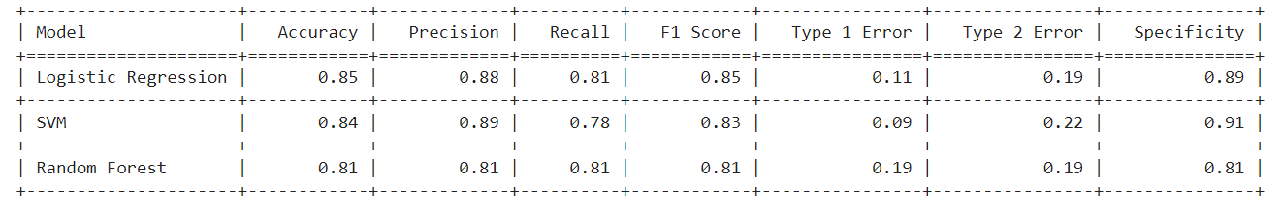
Tabular Representation

Slide 22
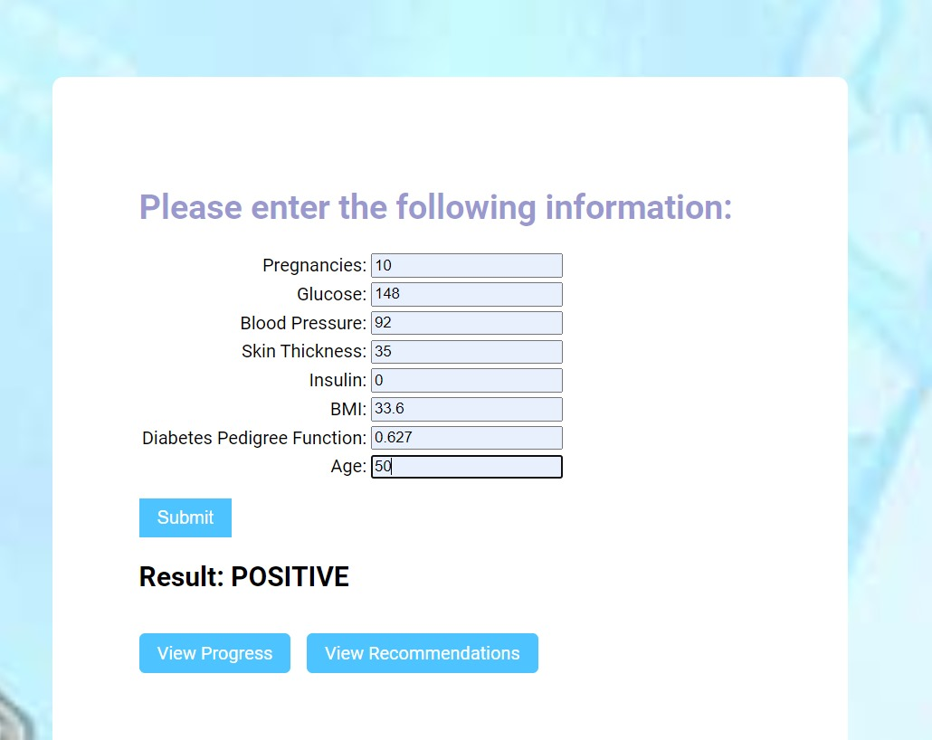
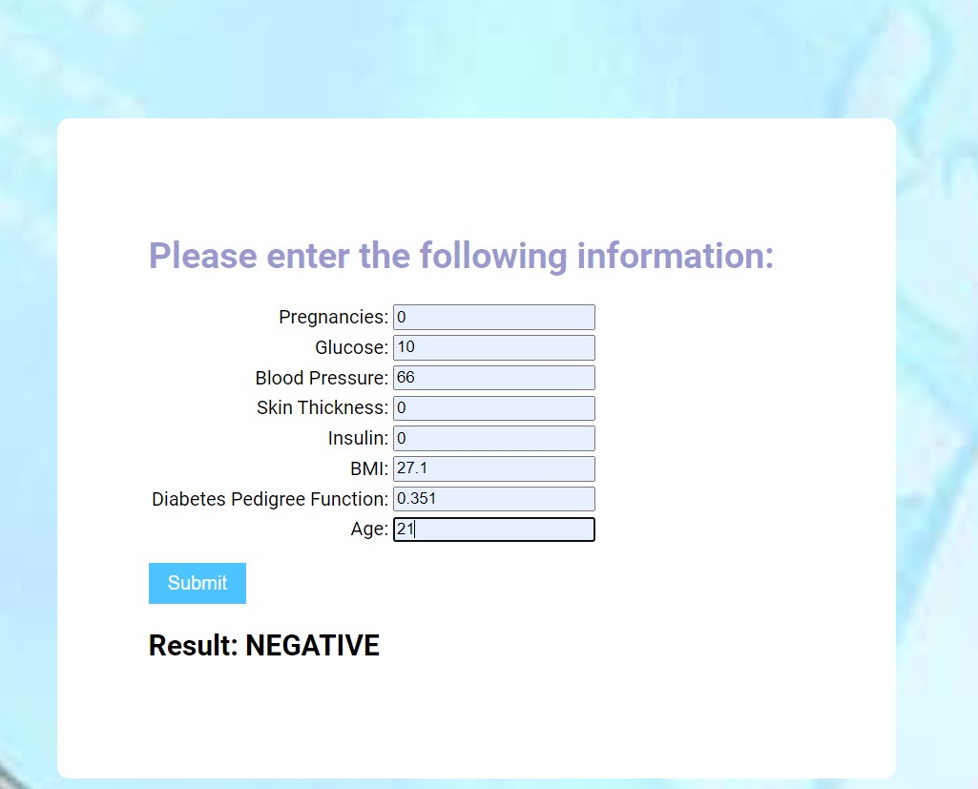
Web Application

Slide 23
Conclusions
The diabetes prediction project effectively integrates machine learning techniques with a user-friendly web interface to provide early diagnosis of diabetes. Utilizing Logistic Regression, Support Vector Machine (SVM), and Random Forest classifiers, the system achieves high accuracy in predictions, offering valuable insights for users based on their health data. The Django-based web application ensures a seamless interaction, allowing users to input their information and receive immediate results. With its emphasis on usability and practical recommendations, this project bridges the gap between advanced data analytics and accessible healthcare solutions, enhancing early detection and management of diabetes.

Slide 24
References
https://www.kaggle.com/uciml/pima-indians-diabetes-database
Aishwarya Mujumdara , Dr. Vaidehi Vb,” Diabetes Prediction using Machine Learning Algorithms” Issue 2019
Tong, Hau Lee and Ng, Hu and Arul Ananthan, Harannesh (2024) ”Predicting Diabetes Mellitus with Machine Learning Techniques”. Journal of Engineering Technology and Applied Physics, 6 (1). pp. 91-99. ISSN 26828383
Mitushi Soni , Dr. Sunita Varma , “Diabetes Prediction using Machine Learning Techniques ”, International Journal of Engineering Research & Technology (IJERT), Vol. 9 Issue 09, September-2020

